Slide 1

`
Data Visualization
With Python & Tableau
Isaack Mwenda
Zalego Institute of Technology

Slide 2
Data overload??
Are you struggling to get organised??

Slide 3
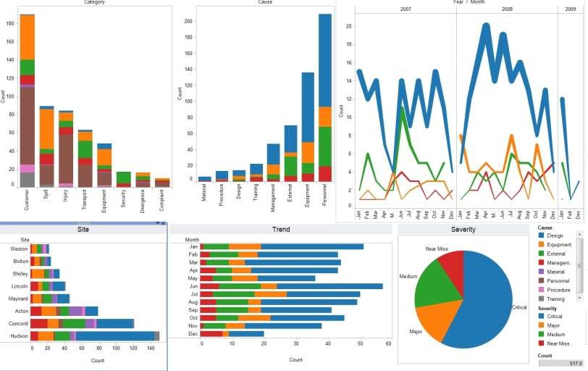
If there is problem, there is a solution..

Slide 4

Data visualization is a general term that describes any effort to help people understand the significance
of data by placing it in a visual context.
Patterns, trends and correlations that might go undetected in text-based data can be exposed and recognized easier with data visualization software.

Slide 5

Visualization is the Language of The Eye

Slide 6
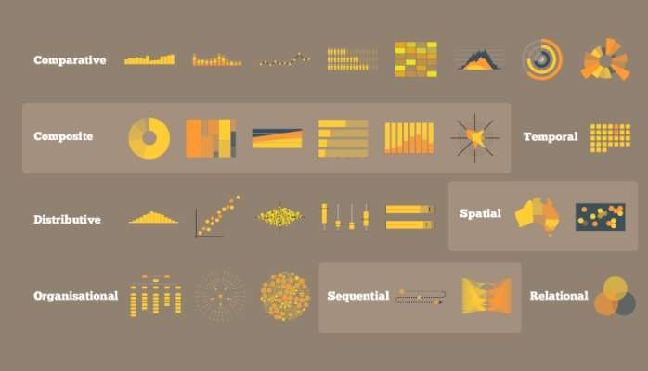

How you can do it?

Slide 7

Best part about Data Analytics is you have to use your full brain.
Left and Right brain, both.
Data Analytics
Data Visualisation

Slide 8
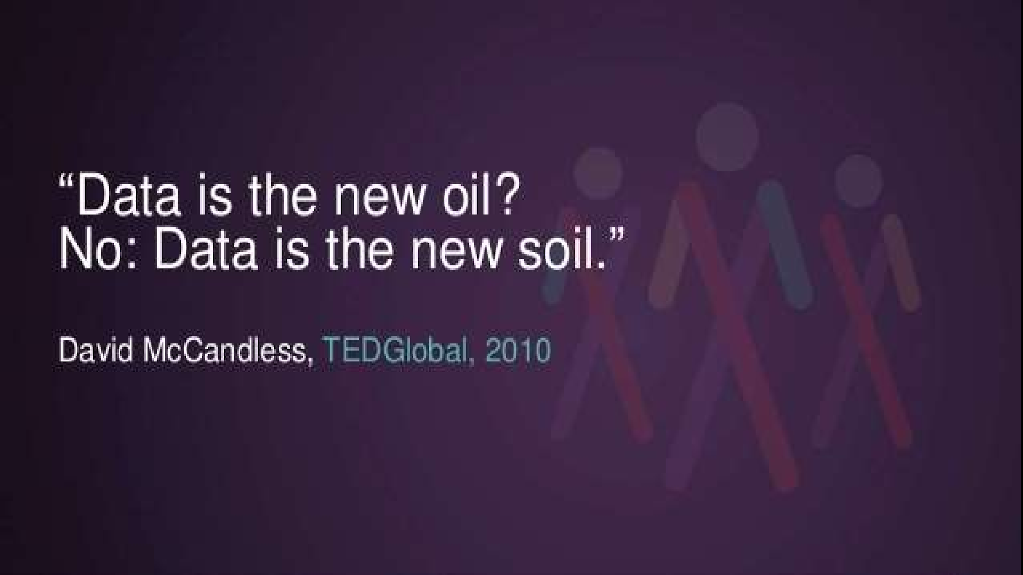

Slide 9
Oil is valuable. If you find, collect and store oil it will remain valuable. Data is a very different thing. Data is generated when people do something. It is a record of an event. That means it starts losing value almost as soon as it is generated because it ages. We can see trends and obtain insights but to get real value from data it must be used in real time. Simply gathering and storing data is a pointless exercise.

Slide 10

Working with data has never been this easy..

Slide 11
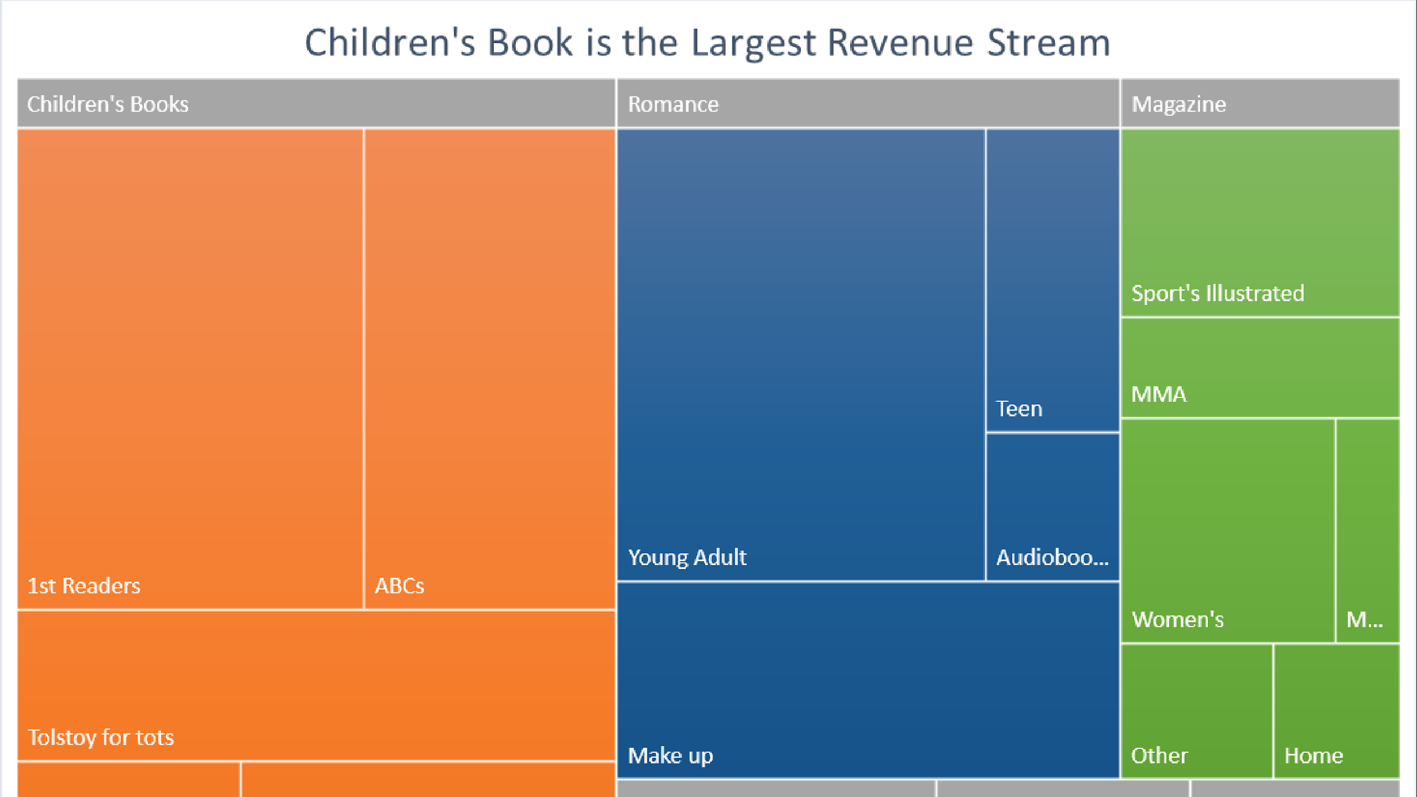
Reveals patterns

Slide 12
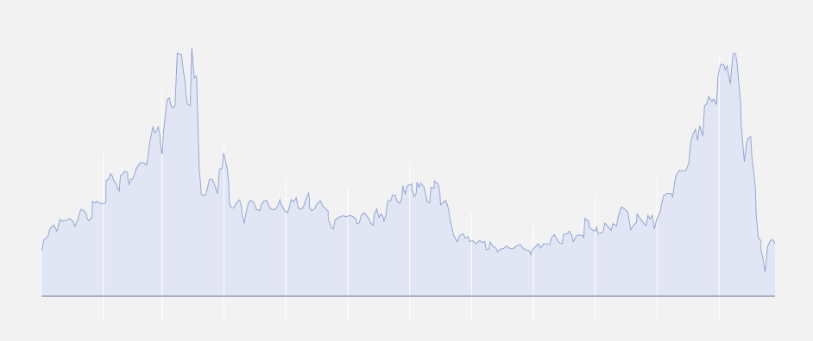
What Does This Visualization represent

Slide 13
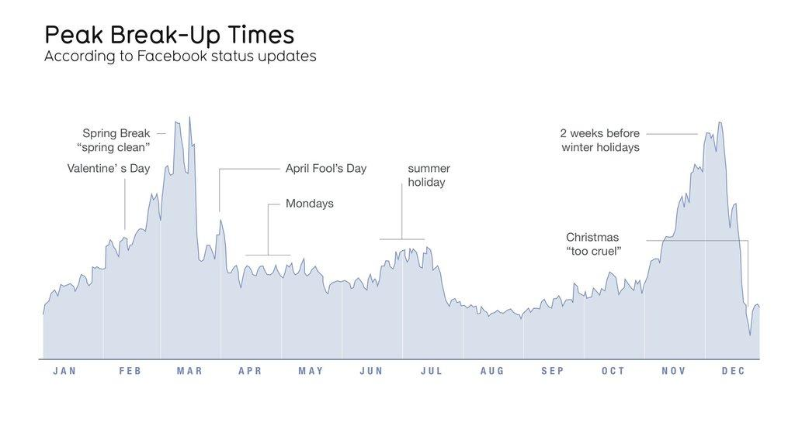

Slide 14
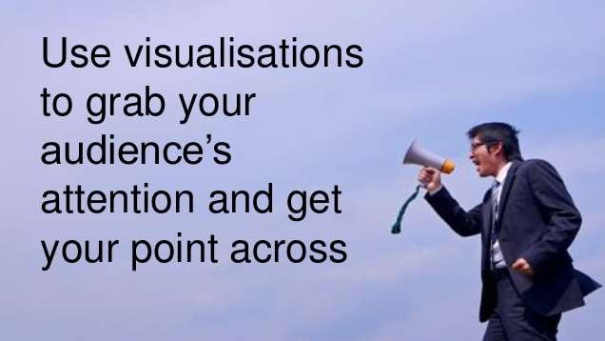
Visuals are more effective than numbers.
Our mind comprehends more data in form of graphics. It is language of eyes and enhances experience of data reading

Slide 15
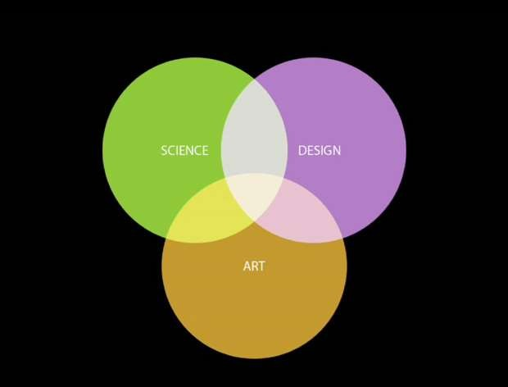
Now, is this diagram justified?

Slide 16
Now, is this diagram justified?
Coding, Analysis
Data frames, tools
Visualisation, infographics

Slide 17
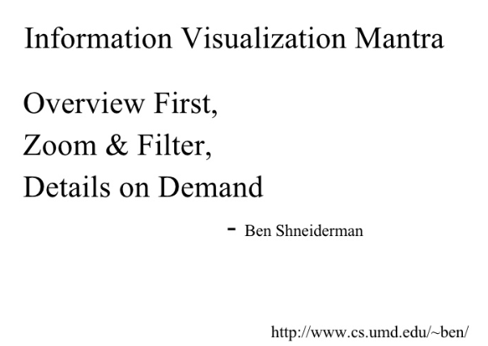
The Mantra Of Data Visualization

Slide 18
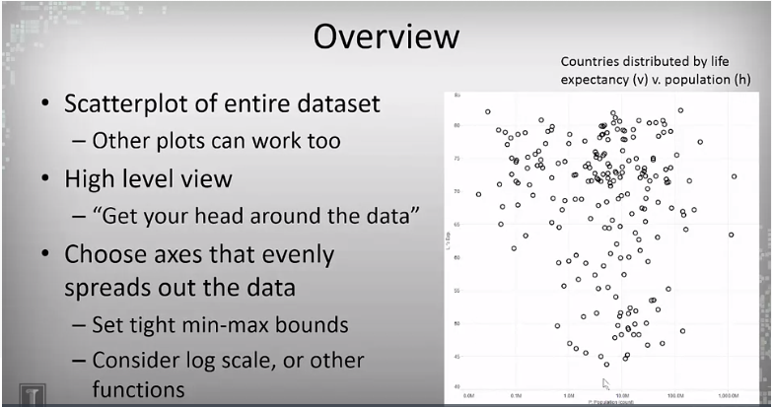
Overview First

Slide 19
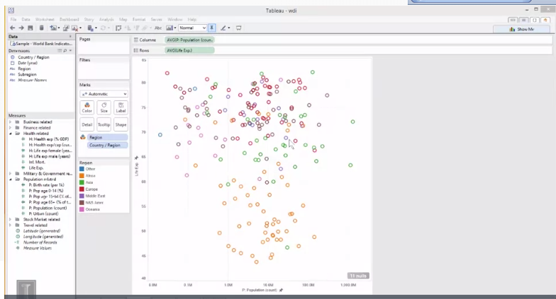
Overview First Cont..

Slide 20
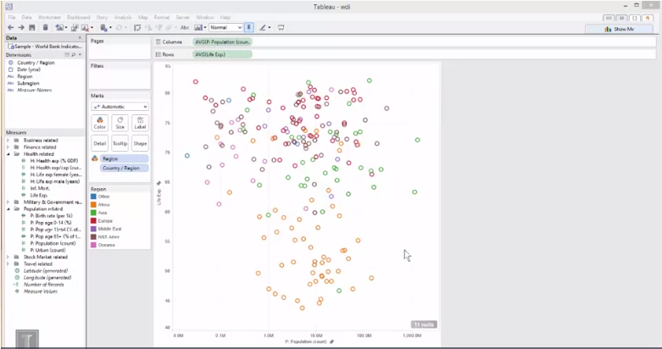
Filter

Slide 21
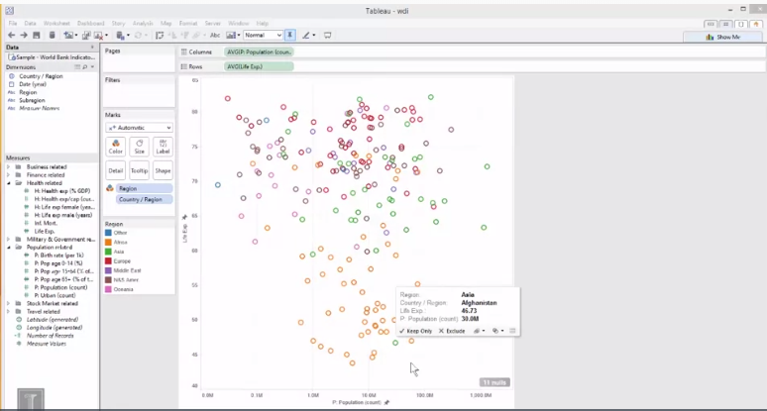
Details On Demand

Slide 22

Prepared by:
Isaack Mwenda

Slide 23
P values
When you perform a hypothesis test in statistics, a p-value helps you determine the significance of your results. Hypothesis tests are used to test the validity of a claim that is made about a population. This claim that’s on trial, in essence, is called the null hypothesis.

Slide 24
The alternative hypothesis is the one you would believe if the null hypothesis is concluded to be untrue. The evidence in the trial is your data and the statistics that go along with it. All hypothesis tests ultimately use a p-value to weigh the strength of the evidence (what the data are telling you about the population). The p-value is a number between 0 and 1 and interpreted in the following way:
A small p-value (typically ≤ 0.05) indicates strong evidence against the null hypothesis, so you reject the null hypothesis.

Slide 25
A large p-value (> 0.05) indicates weak evidence against the null hypothesis, so you fail to reject the null hypothesis.
p-values very close to the cutoff (0.05) are considered to be marginal (could go either way). Always report the p-value so your readers can draw their own conclusions.

